Slide 1
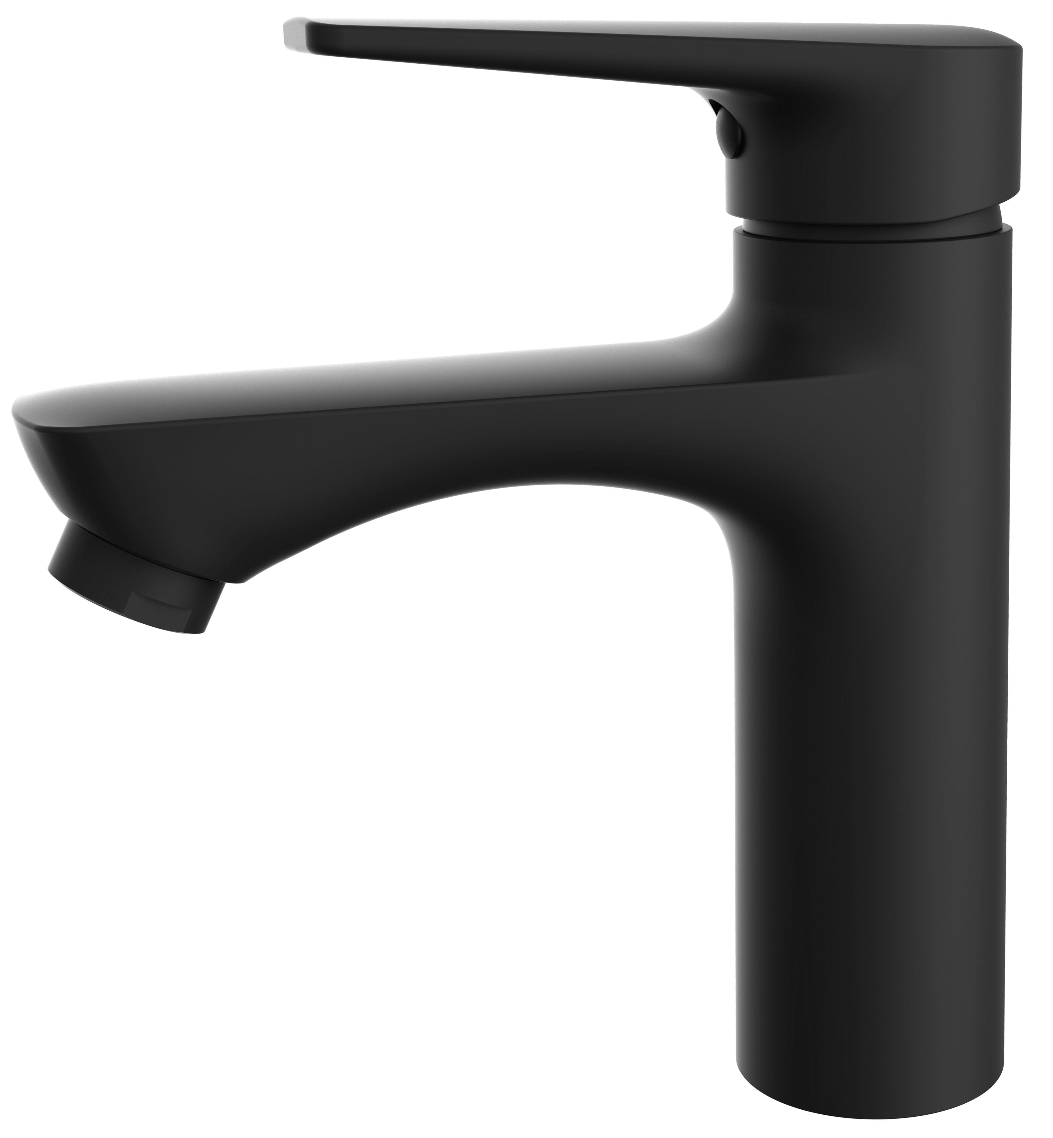
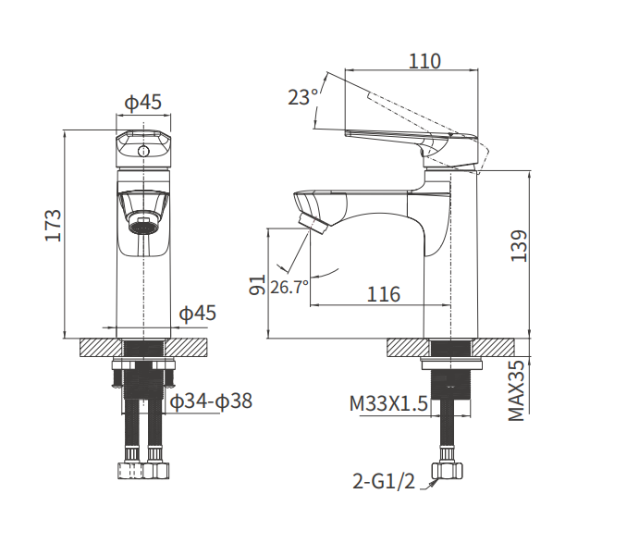
Faucet
Specification
Item Code: AG4127MB
Finish : Matt Black
Material: Zinc Alloy Body + Zinc Handle
Flow Rate: L/min
Water Pressure: 0.05Mpa-0.60Mpa
High-quality Aerator
35mm Ceramic Cartridge
G1/2 Inlet Thread
Stainless-steel Water Supply Hoses x2 (L600mm)
Pop-up Waste is not including
Single Handle controls on/off activation and
temperature adjustment (Hot & Cold)
Installation Type: Deck-mounted
Inner Box Size : / kg
Carton Size: (10Boxes/Carton)
Gross weight: kg

